Slide 1
An Application of Analytics on Revenue Forecasting
ADRIANO, Jade Ericson
BUZON, Andrey Bryan
LOPEZ, Nicole Angelyn
MUNAR, Samantha Karin
PARADO, Justin

Slide 2
Project Context
Revenue Forecasting System for SM Hotels & Convention
Forecasting & Dyanmic pricing to achieve client’s budget goal
Forecasting is currently done manually
Automate forecasting
Notes:
*Andrey
This project is about developing a Revenue Forecasting System designed for Taal Vista Hotel. The team aims to help them in forecasting and dynamic pricing to achieve their budget goal for a certain time interval. Currently, Taal Vista Hotel does not have a Revenue Forecasting System, however they do the computation of dynamic pricing and forecasting manually by gathering data from their database called Opera – a product of Oracle. The project is to automate their manual forecasting by using the data output from Opera and importing it to the Revenue Forecasting System. The team also aims to make innovations for Taal Vista to be more competitive in the Industry.

Slide 3
Purpose and Description
Decision making
Revenue management
Variables
Metrics
Qualitative forecasting
Quantitative forecasting
Notes:
*Jason

Slide 4
Objectives
Automated Revenue Forecasting System
One Year
Forecast
Budget
Room Occupancy Rate
Dynamic Price
5% margin of error
Notes:
*Sam
Our group aims to develop an automated revenue forecasting system for Taal Vista within the span of one year. The system should be able to make forecasts in budget, calculate room occupancy rates, compute and assign dynamic prices. And as a measure of success, any forecasts and projections made by the system should be within a 5% margin of error.

Slide 5
Scope and Limitations
Metrics
Rooms only
Formula Constraint
User discretion
Notes:
*Pam

Slide 6
Applied Concepts:
Time-series analysis
Producing Factors
Modelling
Moving Average
Weighted Moving Average
Exponential Smoothing
Holt-Winters Exponential Smoothing

Slide 7
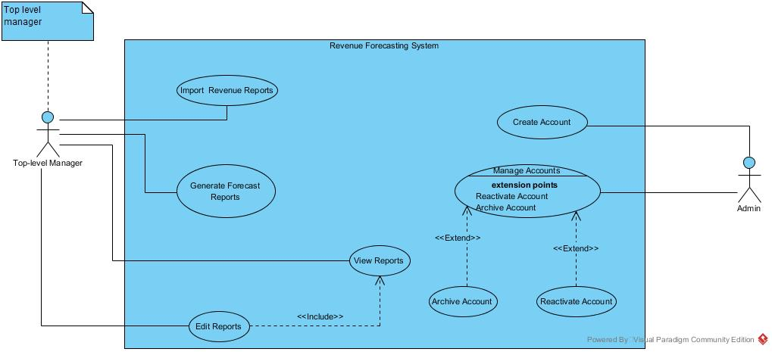
Use Case Diagram

Slide 8
Prototype

Slide 9
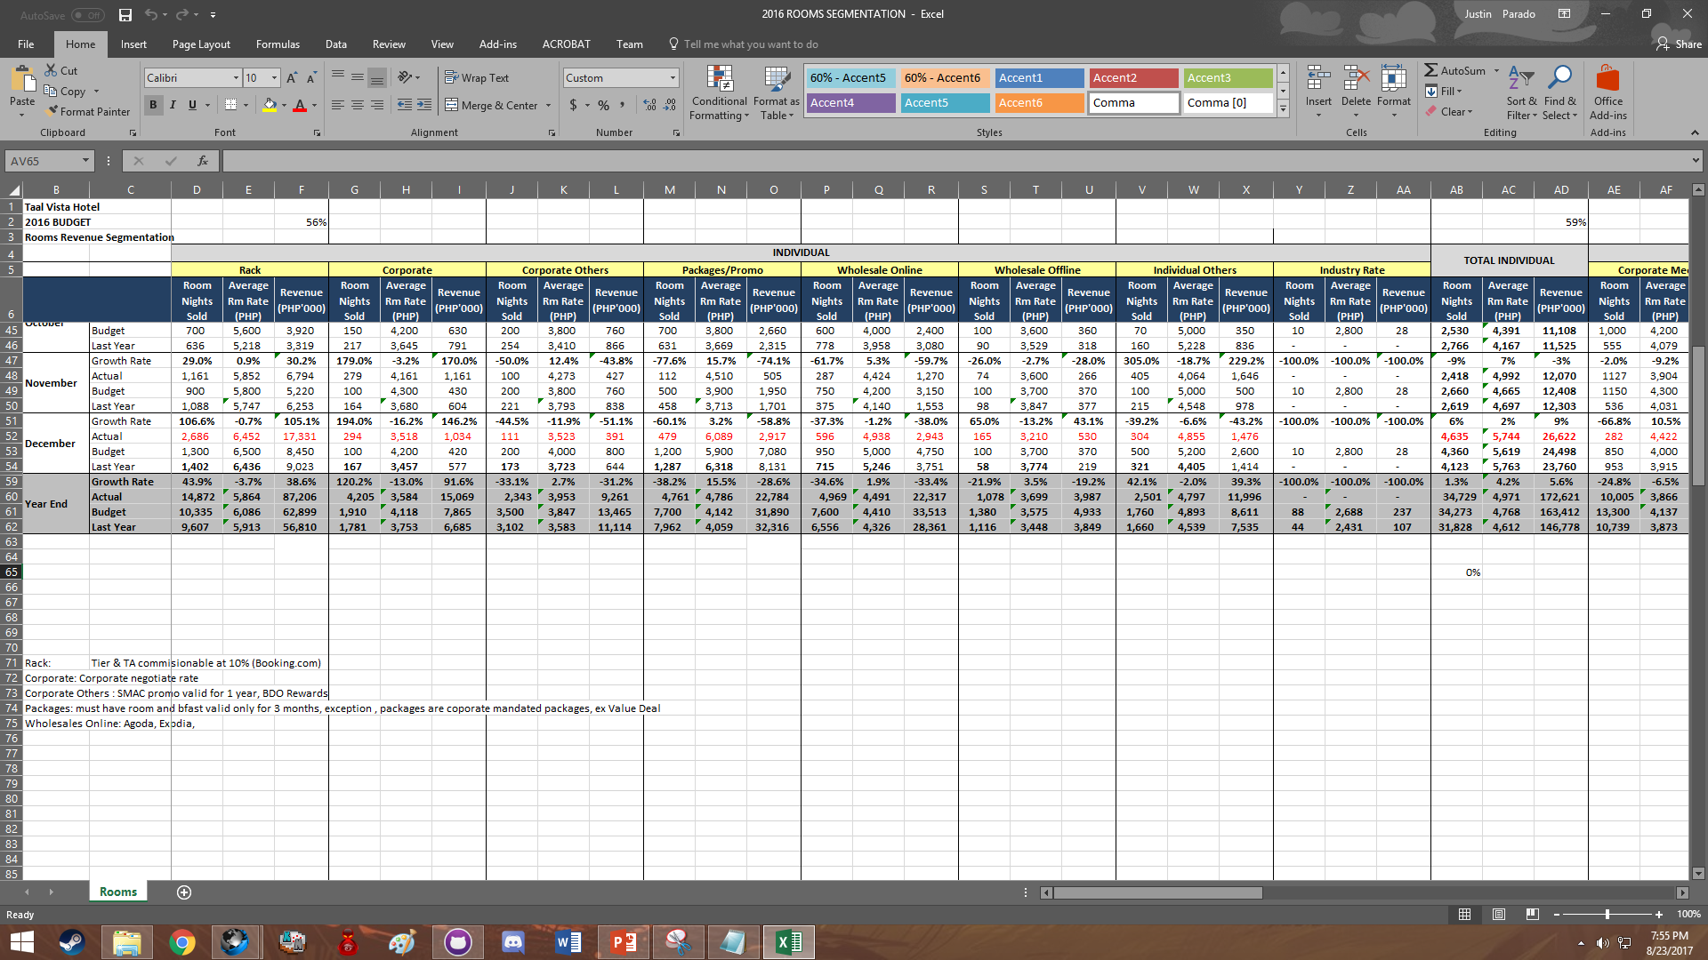
Excel file used as input (Room Segmentation)

Slide 10
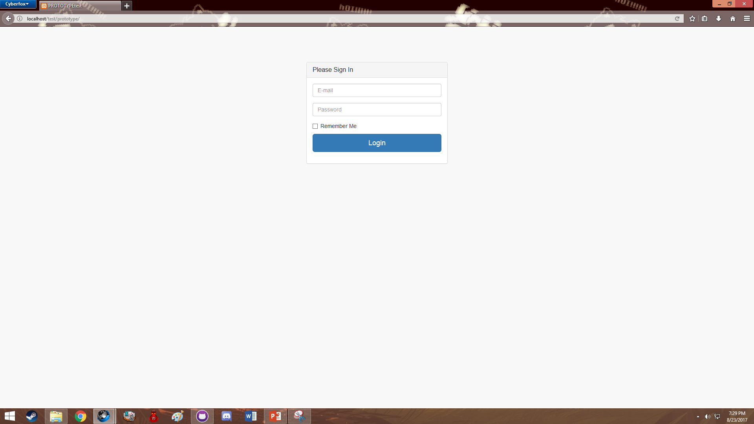
Login Screen

Slide 11
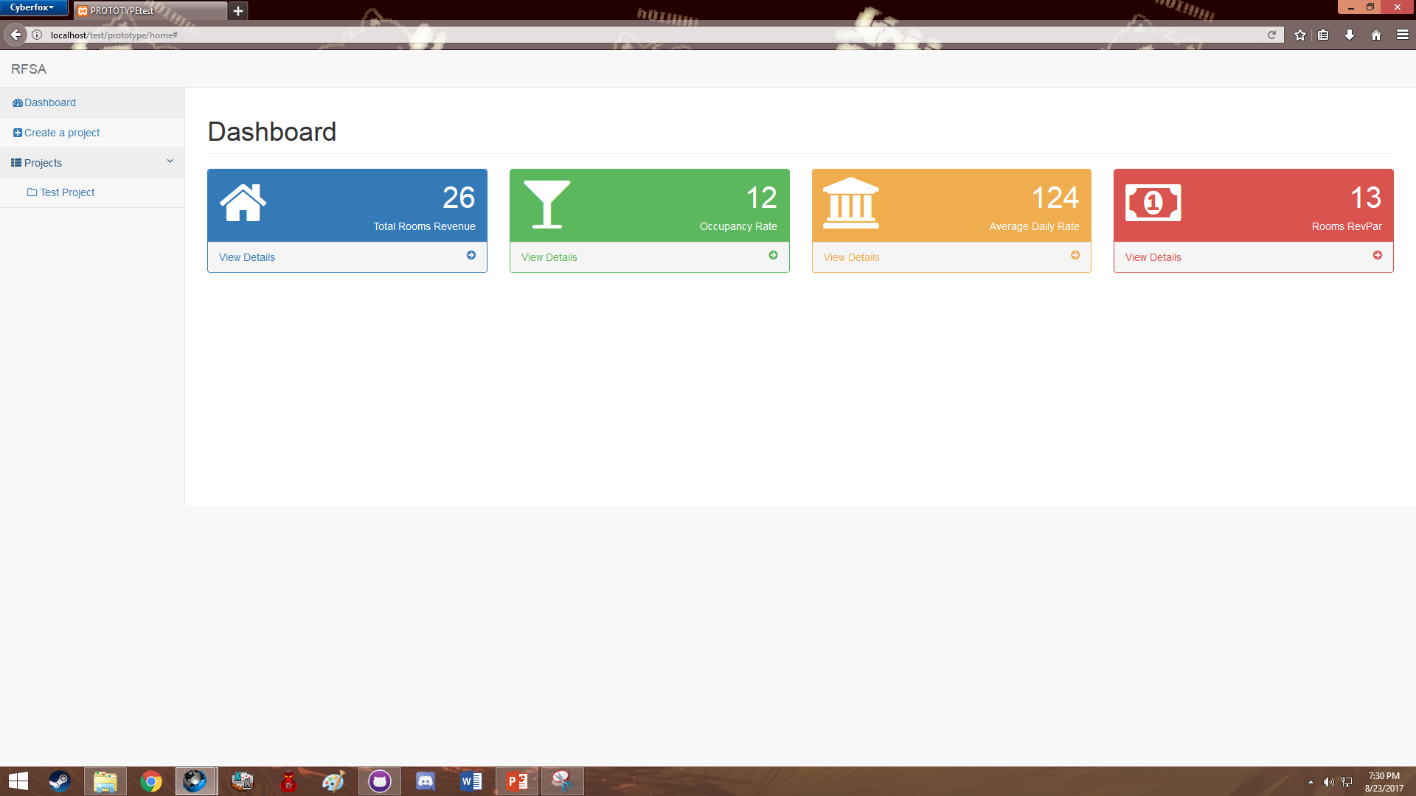
The Dashboard

Slide 12
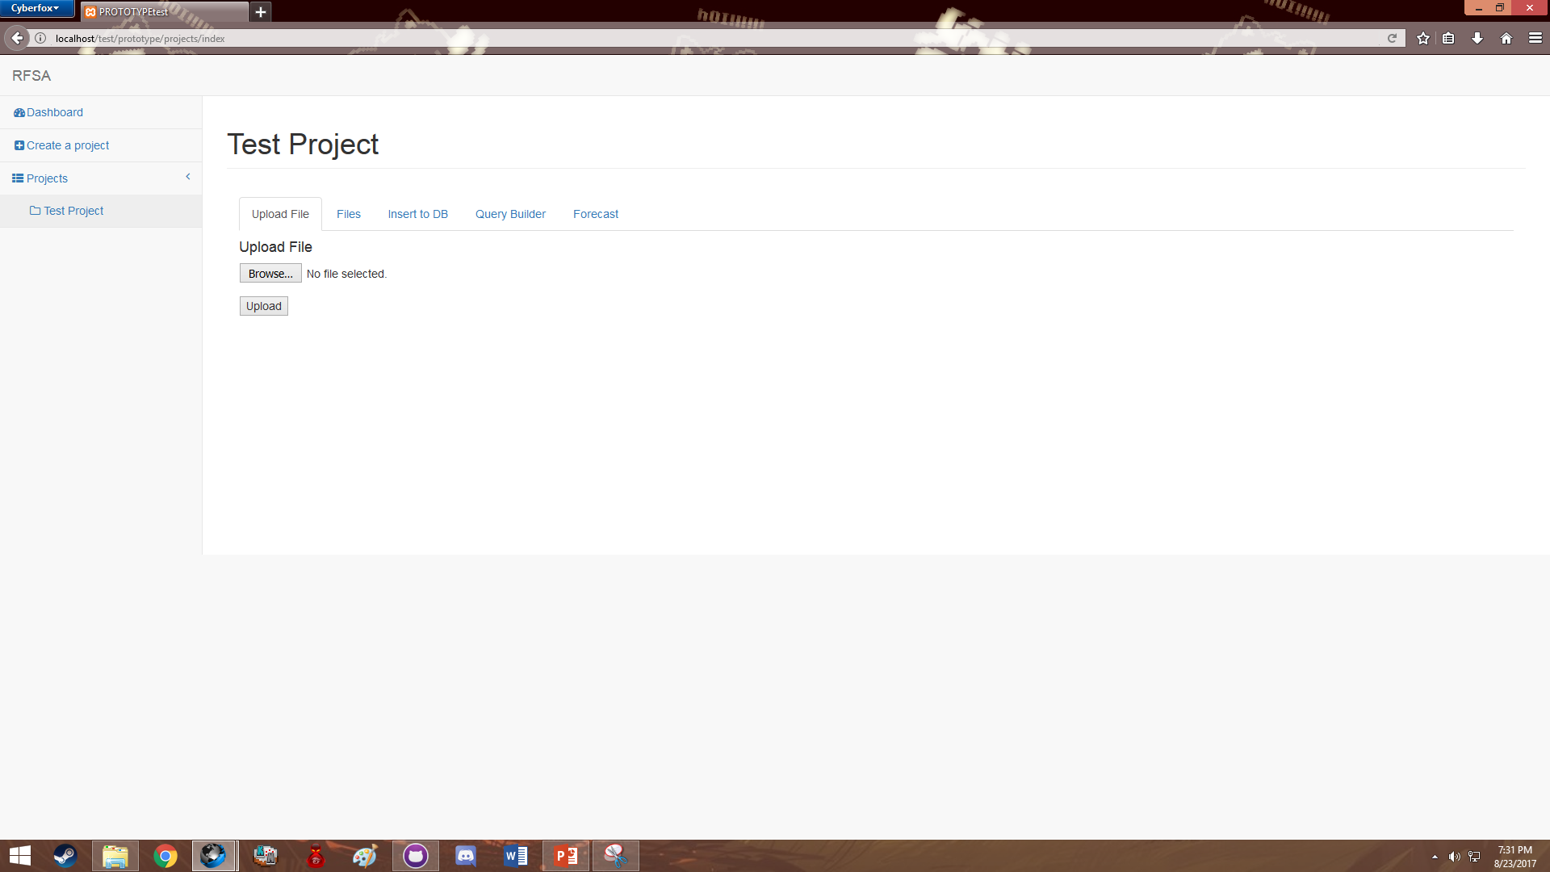
The Projects Tab

Slide 13
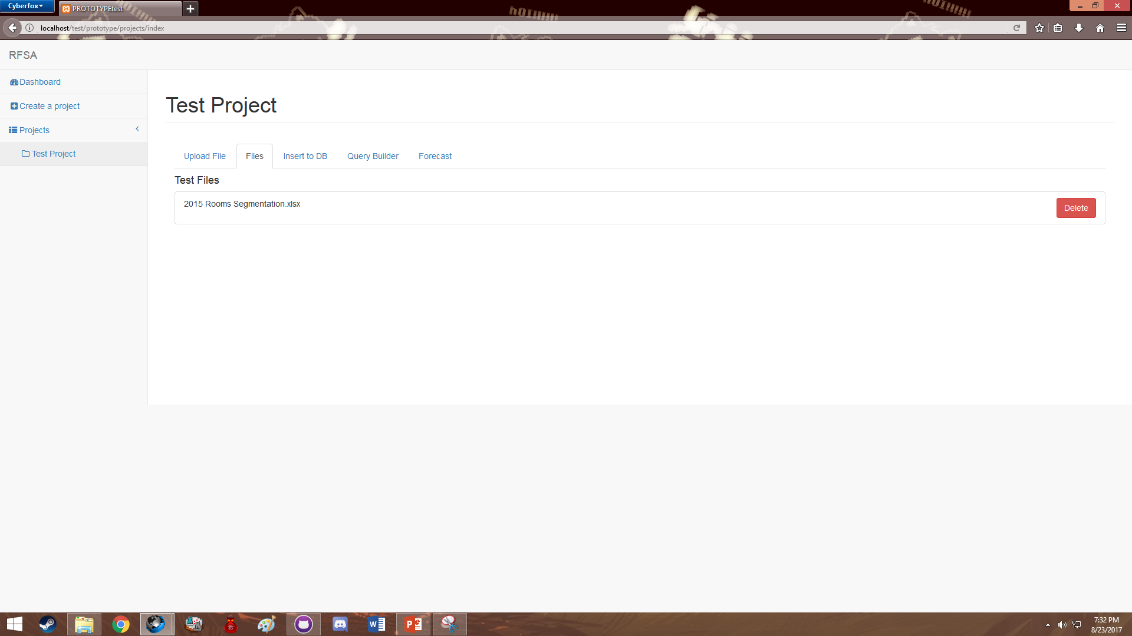
Uploaded Files Tab

Slide 14
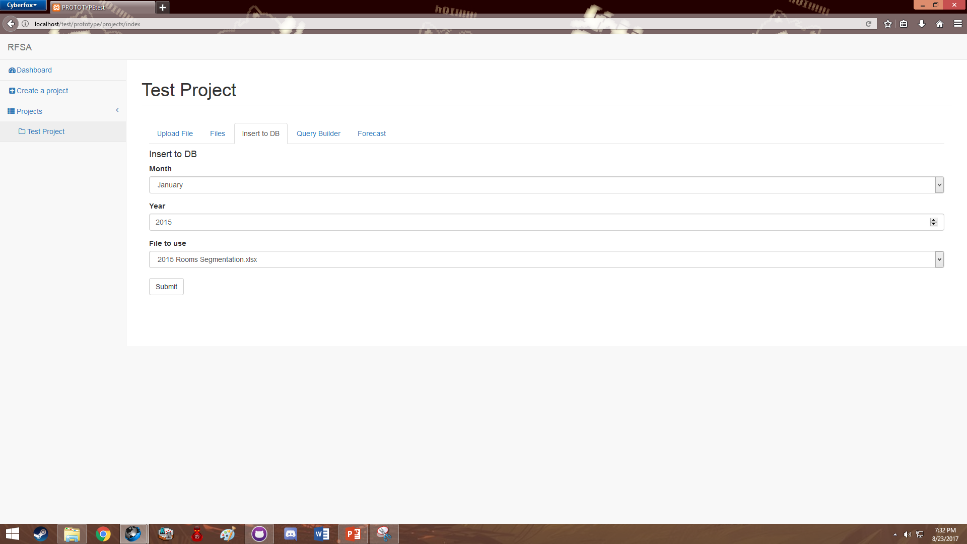
Recording Options Tab

Slide 15
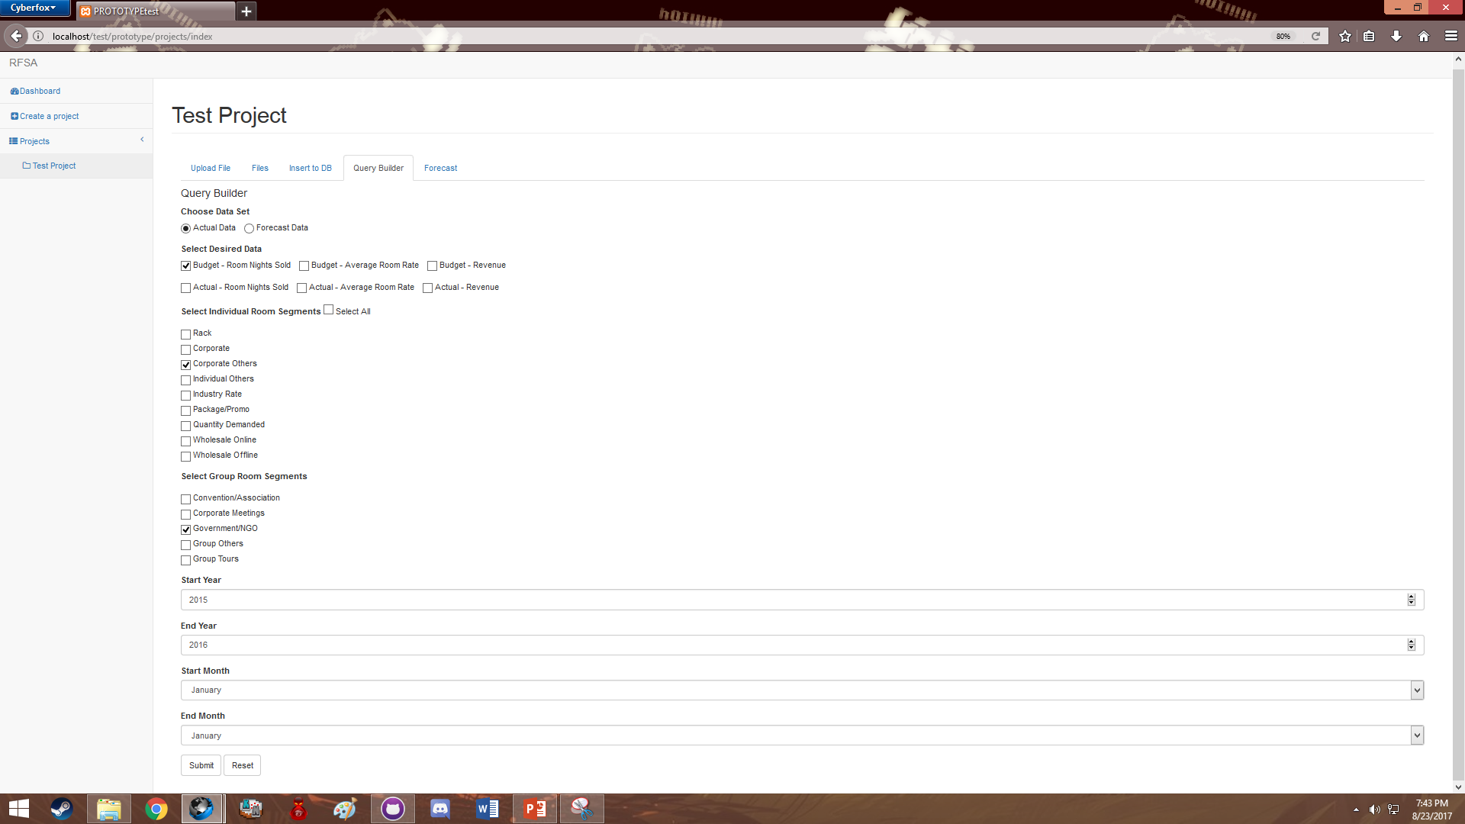
Query Builder (With Sample Input)

Slide 16
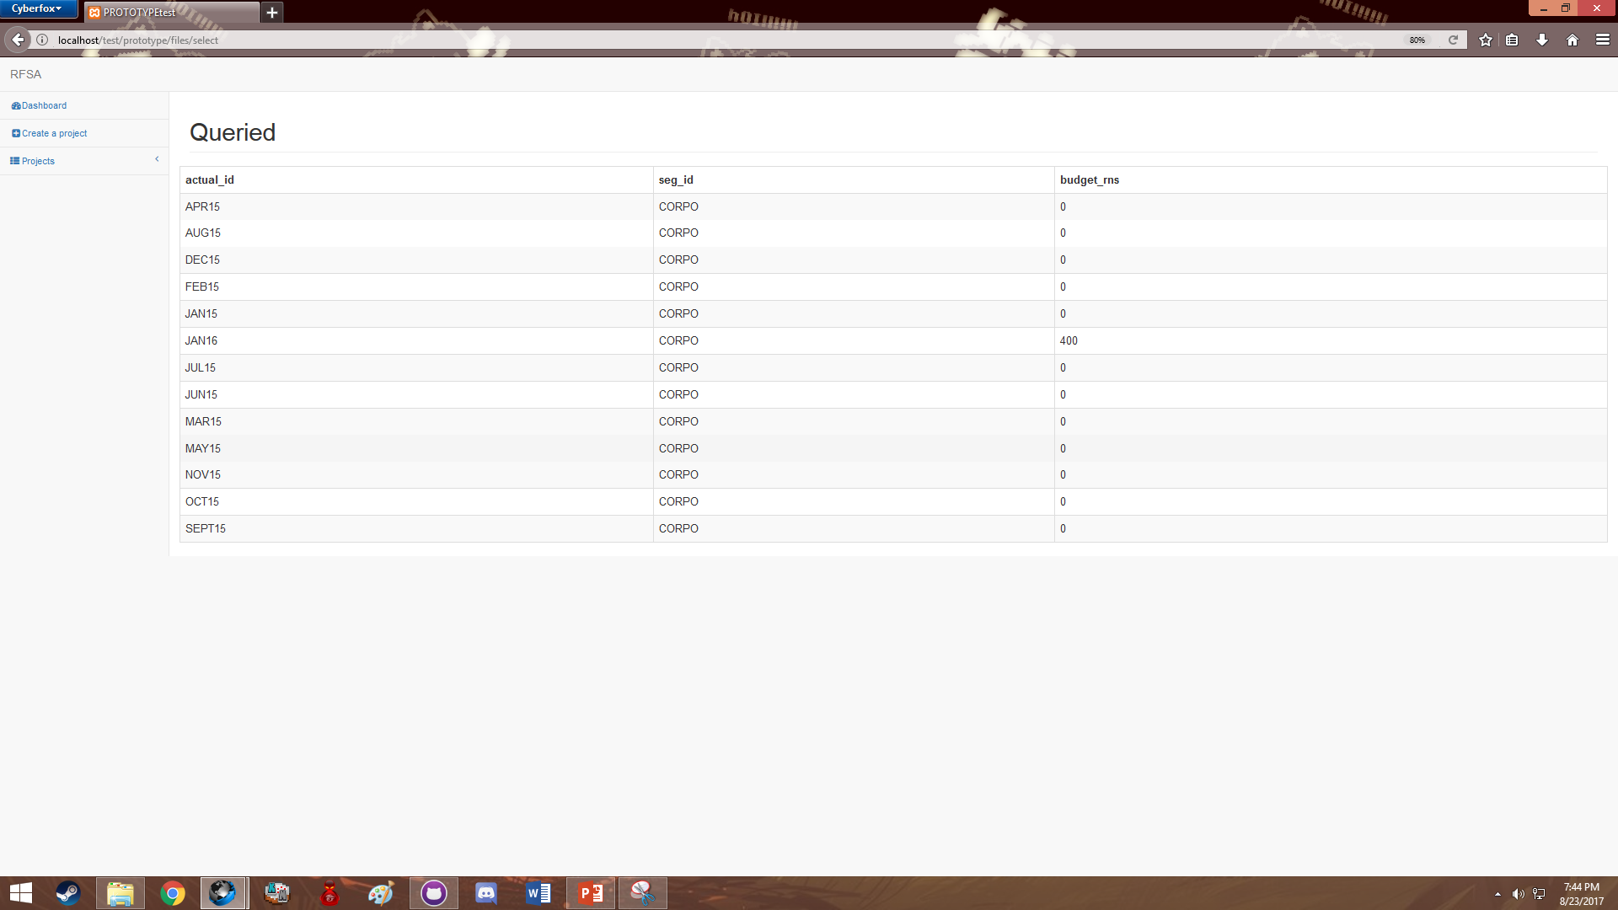
Sample Input’s Output

Slide 17
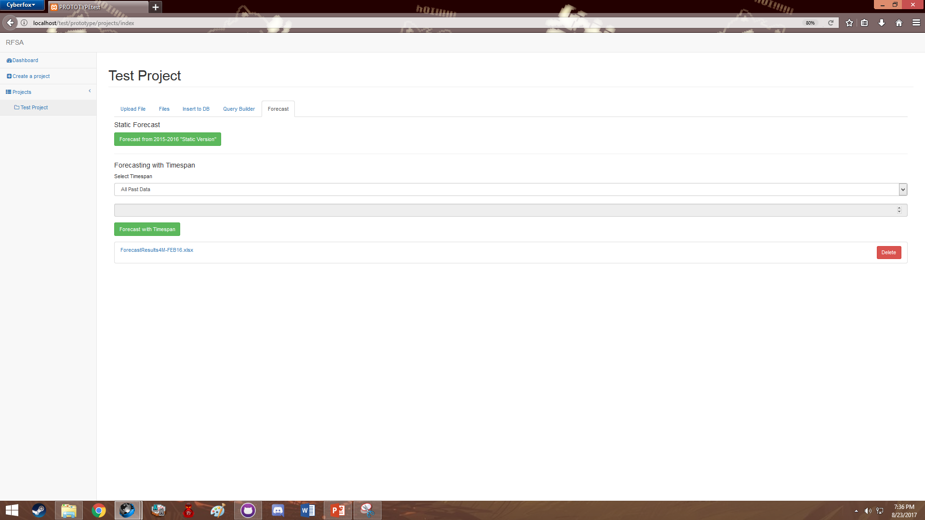
Forecasting Tab
Create a forecast and Download Excel files containing forecast values

Slide 18
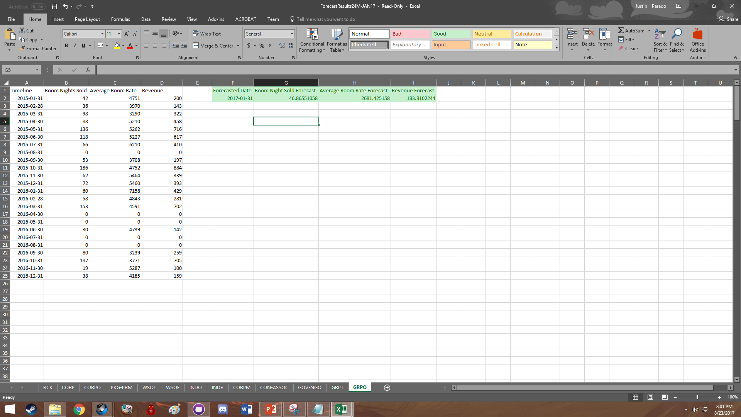
Sample Forecasted Output

